Slide 1
Risk and Spread of Wuhan Coronavirus
Daniyar Akizhanov and Austin Hushower

Slide 2
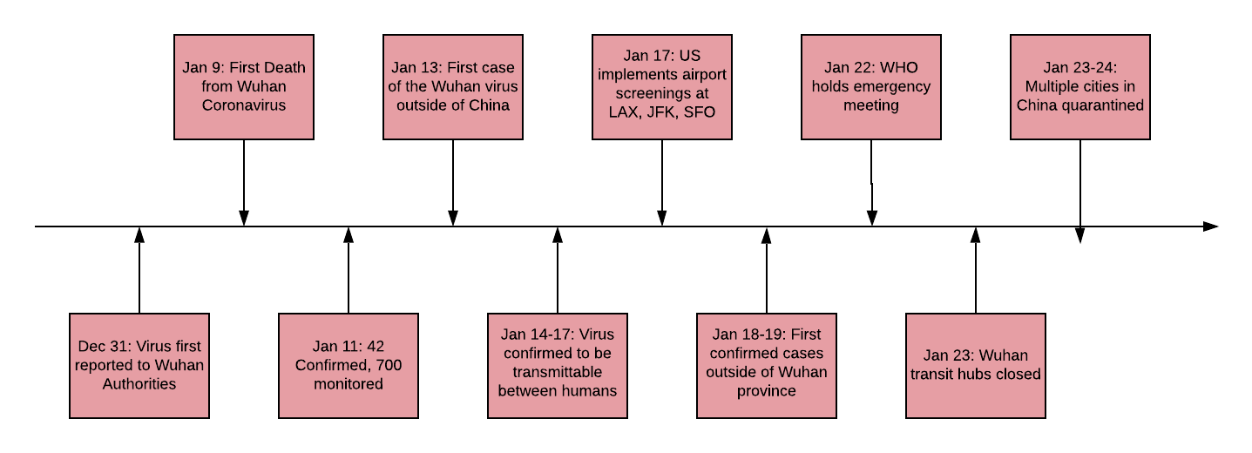
Spread of the Virus

Slide 3

1438
Laboratory Confirmed Cases (1:00 pm)

Slide 4
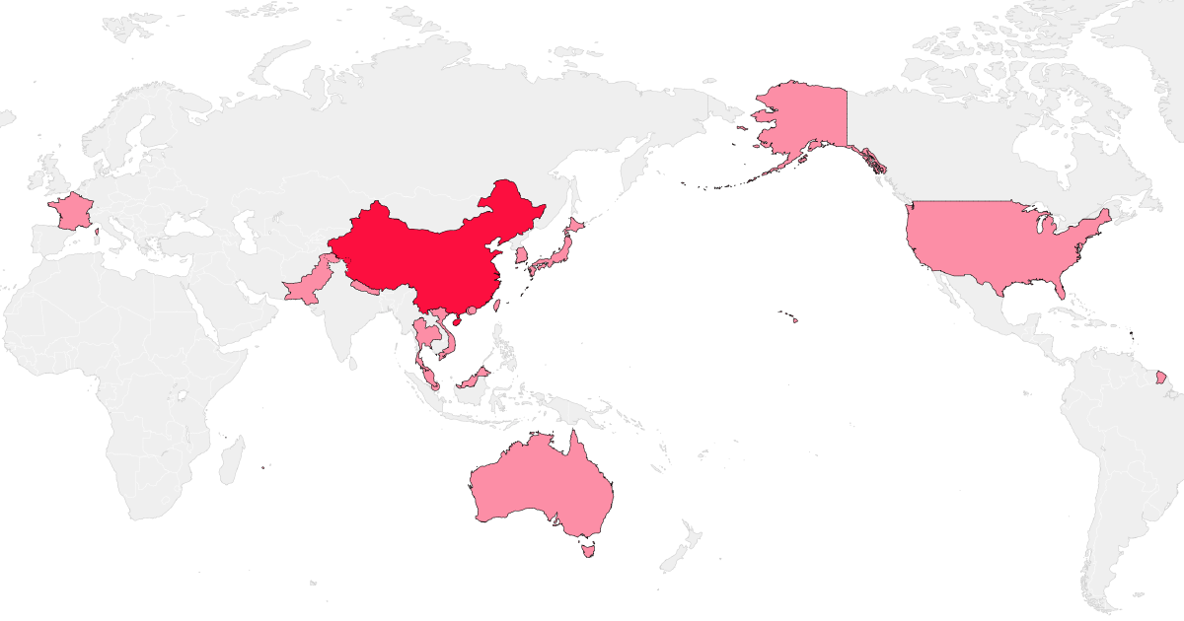
3 Cases
1399 Cases
2 Cases
7 Cases
4 Case
Source: Bloomberg News

Slide 5
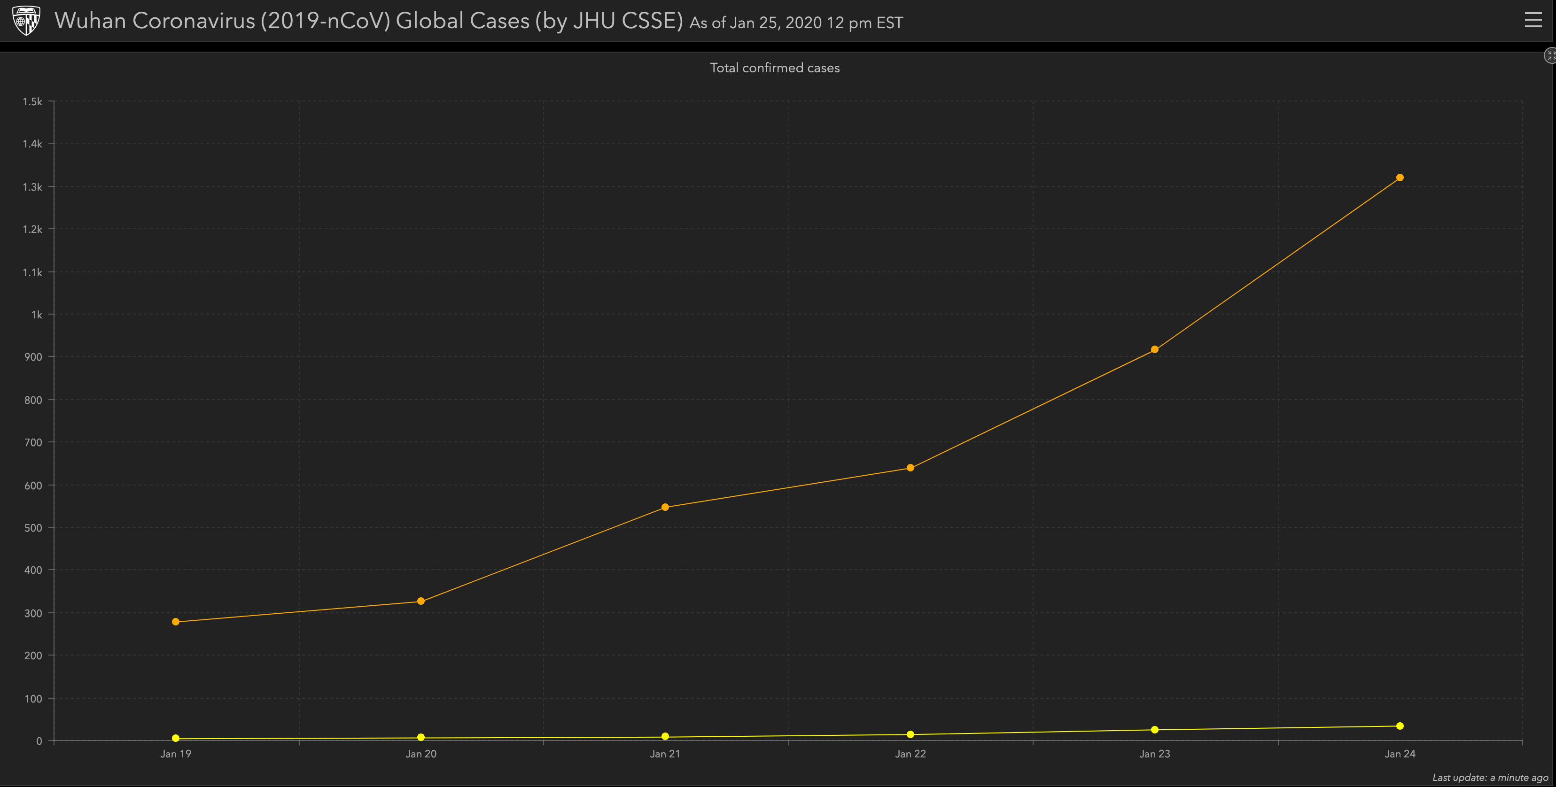
Mainland China
International
Source: JHU CSSE Wuhan Virus Project

Slide 6
Three Questions
Can we accurately quantify the risk of contamination from Coronavirus for each US city?
Which US cities have the highest risk of contraction?
Should Texas airports consider a stronger response?

Slide 7

Risk Quantification

Slide 8
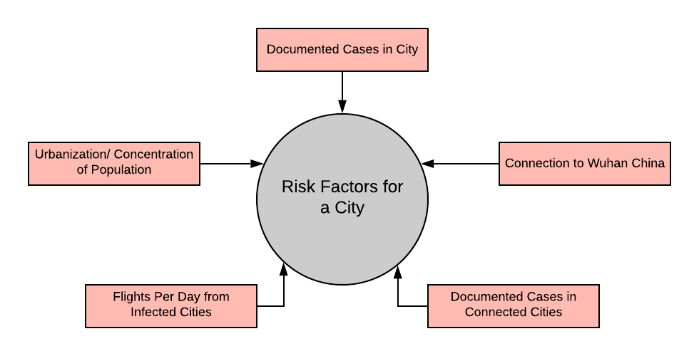

Slide 9
Primary
Secondary
Two Types of risk

Slide 10
Primary
Number of Infected: By far the most significant risk to a city are those who are already there…
Flight Risks: Number of direct flights to China. Note that this can not include Wuhan, as Wuhan airport was closed January 24

Slide 11
Secondary
Second Degree Connections: A city is connected, with at least one stop to a major Chinese city
Traffic at Airport: The volume of passengers at an airport increases the chance for transmission

Slide 12
Data Sources
American and Chinese Flight Records
American Airport Code and Location Database
Wuhan Virus Confirmed Case Numbers

Slide 13
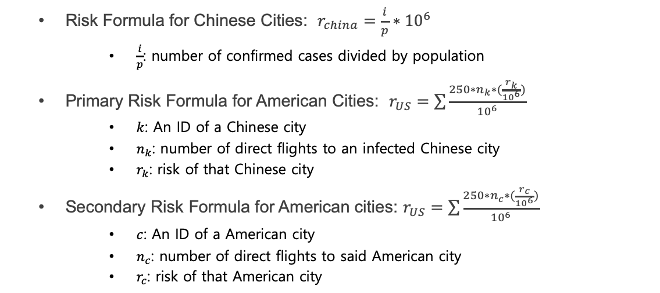
Formulas
Risk Formula for Chinese Cities: $r_{china}=\frac{i}{p}∗{10}^{6}$
$\frac{i}{p}$: number of confirmed cases divided by population
Primary Risk Formula for American Cities: $r_{US}=\sum{\frac{250∗n_{k}∗(\frac{r_{k}}{{10}^{6}})}{{10}^{6}}}$
$k$: An ID of a Chinese city
$n_{k}$: number of direct flights to an infected Chinese city
$r_{k}$: risk of that Chinese city
Secondary Risk Formula for American cities: $r_{US}=\sum{\frac{250∗n_{c}∗(\frac{r_{c}}{{10}^{6}})}{{10}^{6}}}$
$c$: An ID of a American city
$n_{c}$: number of direct flights to said American city
$r_{c}$: risk of that American city

Slide 14

Highest Risk Cities

Slide 15
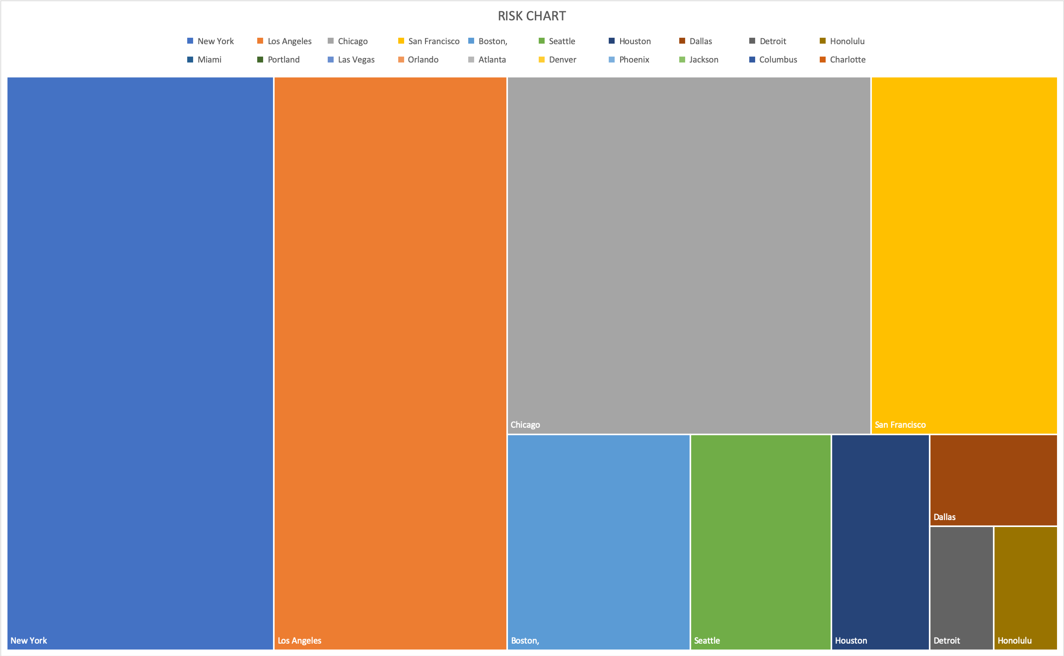

Slide 16
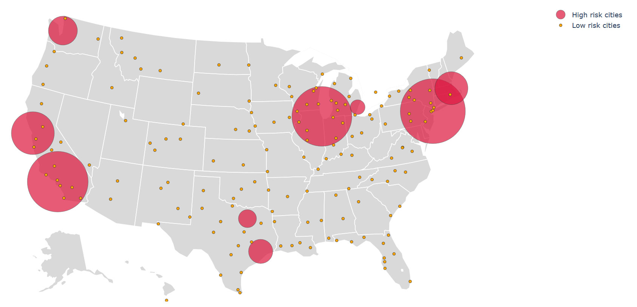

Slide 17
Nationwide Protocol
Mandatory Screenings
Mandatory screenings are in effect for anyone arrivals from the Wuhan area. Screenings occur at airports deemed “high risk” by the CDC: LAX, JFK, SFO, ATL, and ORD
Flights Rerouted
Any passenger whose journey originated in Wuhan China, or the Hubei province will be rerouted to one of the five aforementioned airports.
According to the CDC, the immediate health risk to the general American public “is considered low at this time.”

Slide 18

Risk to Texas?

Slide 19
Texas Protocol
IAH
Flyers posted warning travelers of the risks. Travelers are advised to avoid meat markets, touching living or dead animals, handling uncooked meat or being near sick people while in China
DFW
As of December 24, no new procedures have been implemented. Officials, however, note that “DFW Airport’s first responders are trained and prepared to support the CDC”

Slide 20
A Case for Stronger Measures
Direct Connection
Similarity in Data
Scope of Virus

